Slide 1
DAV FINAL PROJECT Usage of Internet
GROUP MEMBERS
ADITYA PAI
JASH SHAH

Slide 2
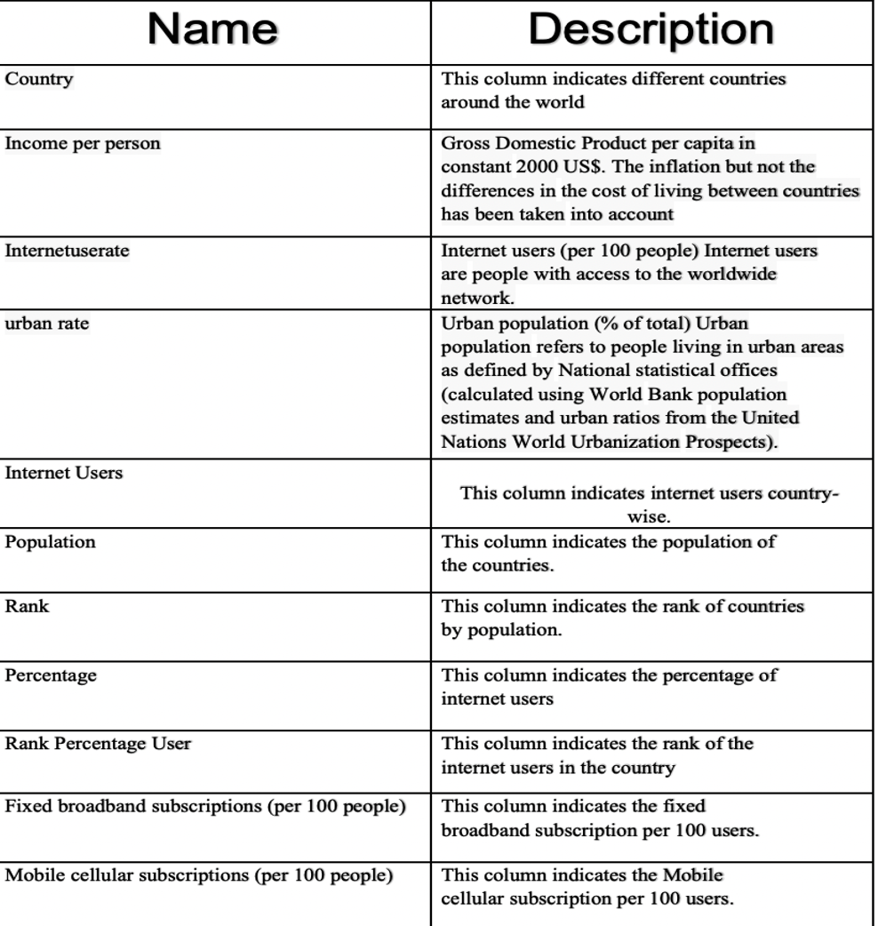
DATA DISCRIPTION

Slide 3
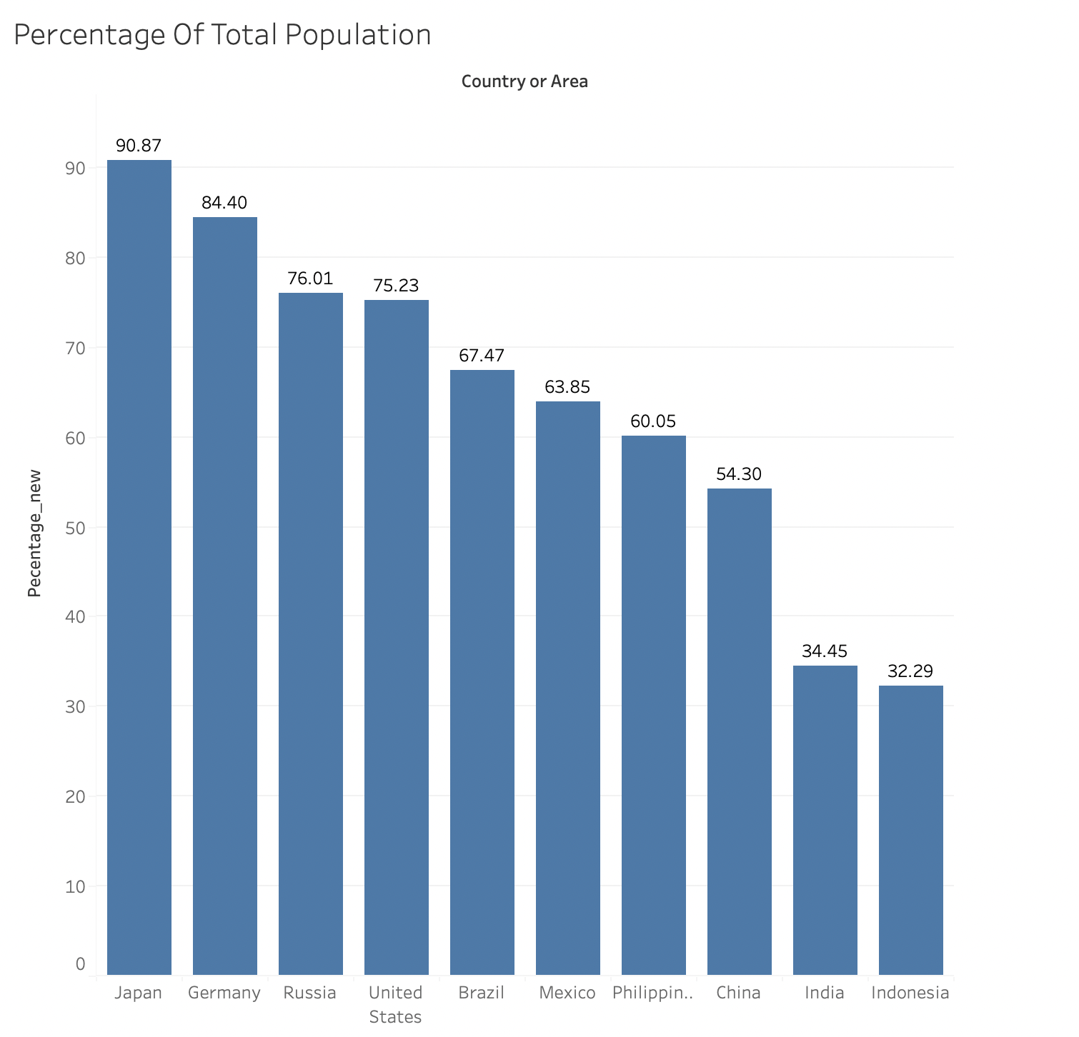
INTRODUCTION
We will be first doing an EDA on our data, here we will be checking the leading countries with maximum percent of the population using internet.
Japan and Germany have maximum percent of population using internet.

Slide 4
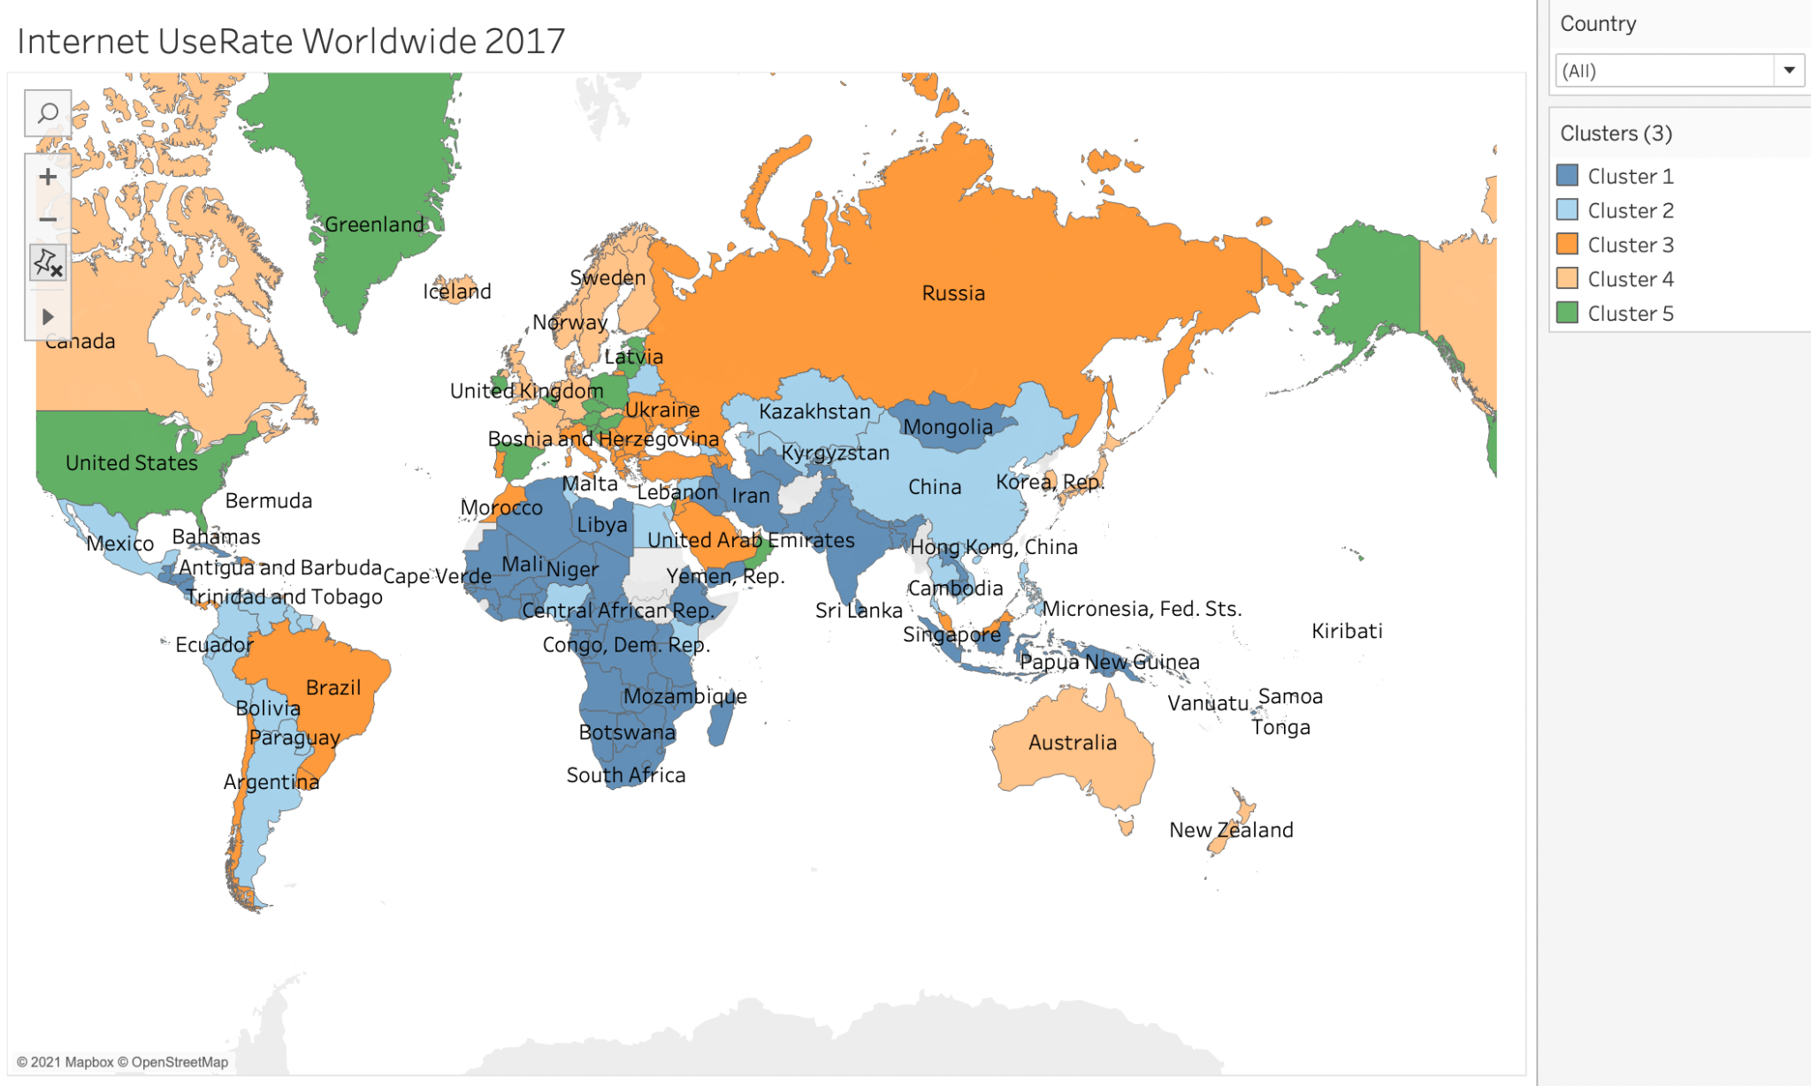
INTERNET USER RATE BASED ON CLUSTERING
In this map graph we have clustered the countries who have similar Internet user rate. The internet user rate is the percent of the population that is using internet.
We have made five clusters, this explains us that, countries with higher population will have worse user rate than countries with less population.

Slide 5
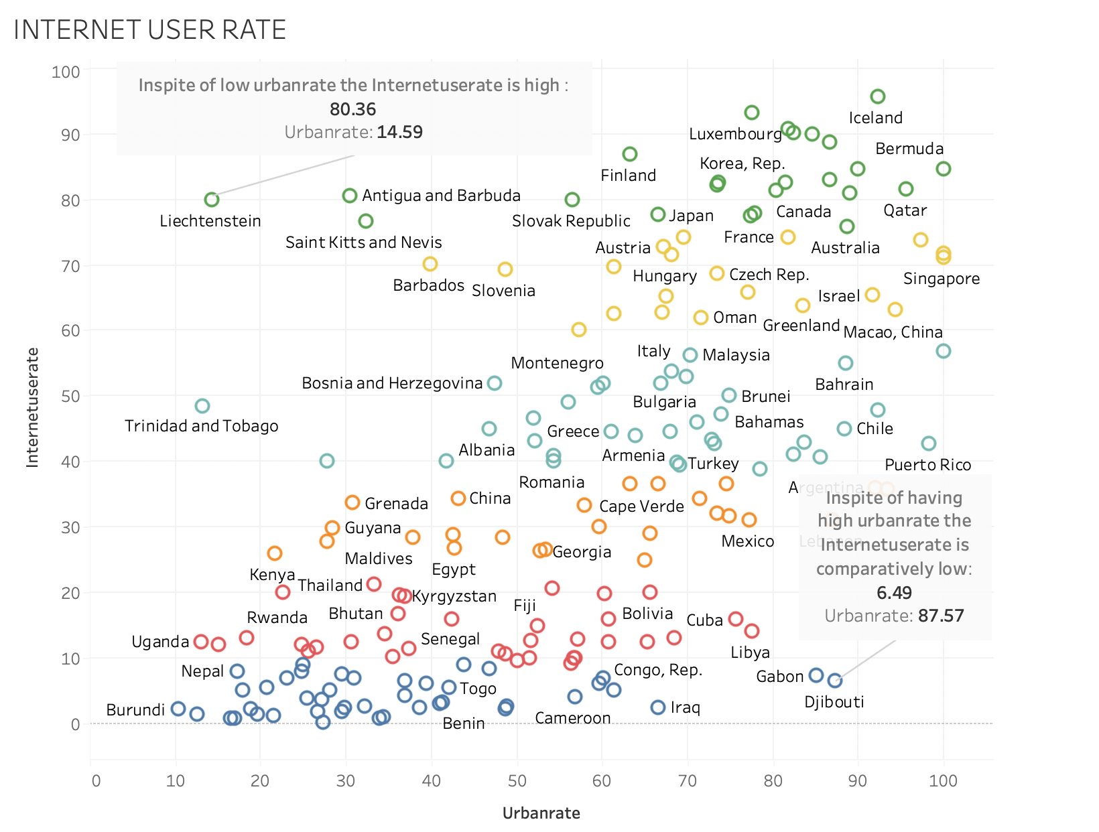
SCATTER PLOT
Here we can take a look at the scatterplot of the clustered countries on the basis of internet user rate and urban rate.
It can be clearly see that the urban rate has positive correlation with the user rate, the better is the urban rate better will be the user rate.
We can have a look at a few special cases ( annotated on the top and bottom )

Slide 6
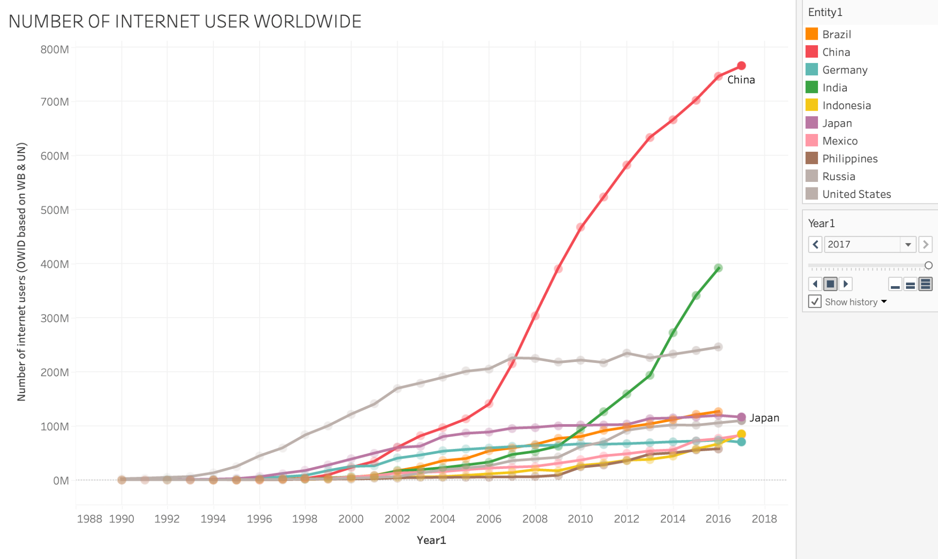
INTERNET USER
This is the graph that is showing us the growth in internet users over the history of time.
In this graph we can see that almost no country had access to the internet.
In 2005 most of the countries around the world had started using internet. We can also see that there is a huge spike in most of the countries graph after 2009.
-India, China, United states can be clearly seen as the outliers.

Slide 7
Dividing the data into three parts
We will be dividing our data into three parts, as there is a huge increase in the number of users in the recent decade, we can state that if we try to visualize the 1990 data with the 2016 data we will not be able to compare.
Plus the internet was only accessible in some parts of the world in early days, which makes it better to analyse the data individually.
We can take a look at the radar graph from 1990-2000.

Slide 8
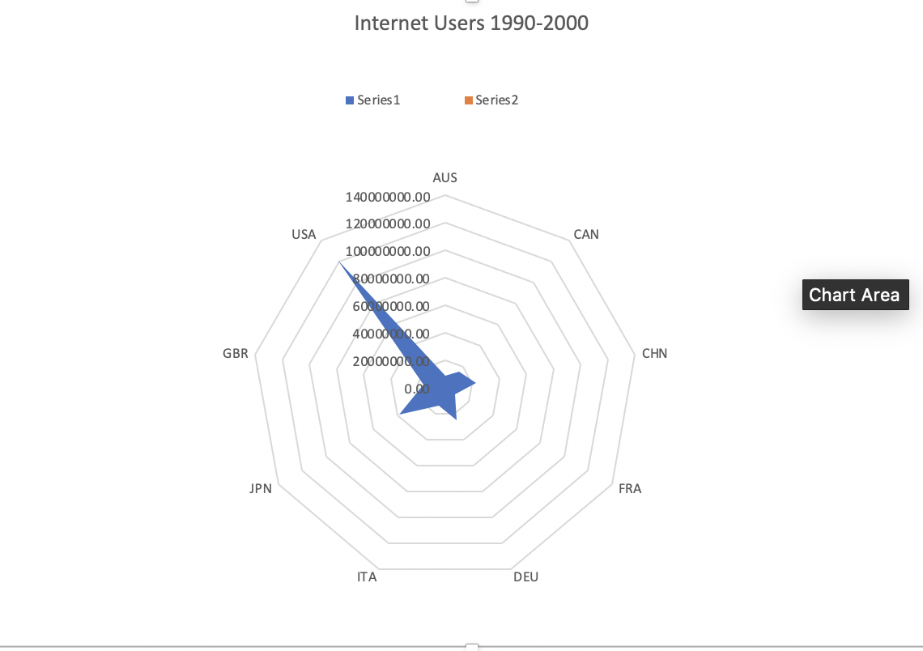
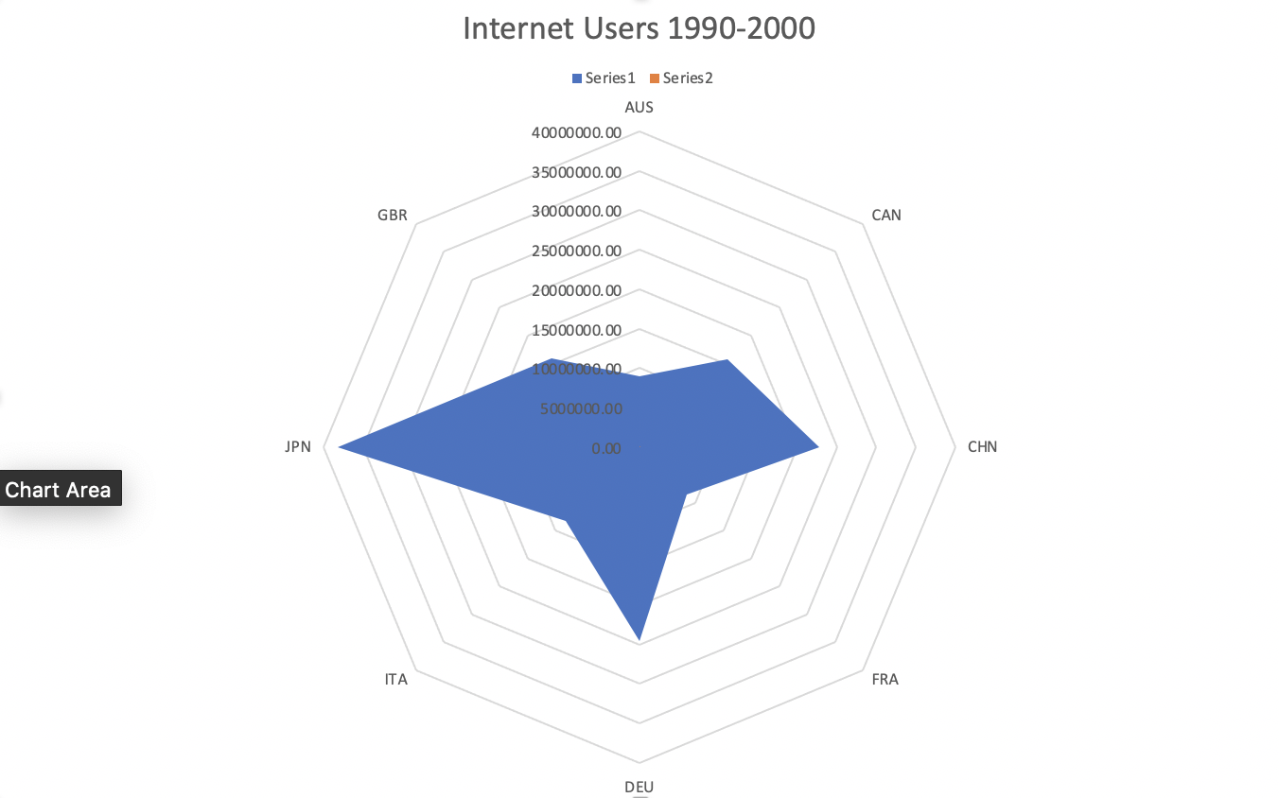
EDA 1990-2000

Slide 9
INSIGHTS
We can see from the graph that USA had a major lead in the number of users that used the internet back in 1990, we have already mentioned that most of the countries did not have internet.
We will be looking at some of the significant countries, after the US, they were Japan, China and Germany.
Research says the main reason for the growth of internet during this time was new technologies, we can notice that the countries that are mentioned above, have developed technology industries which is the main reason for the growth of internet in this era.

Slide 10

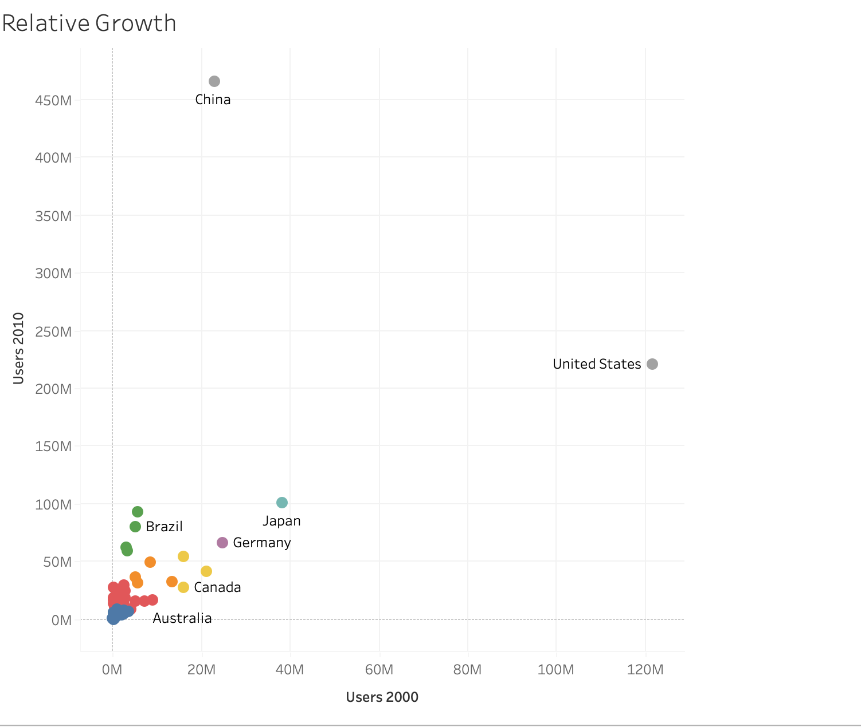
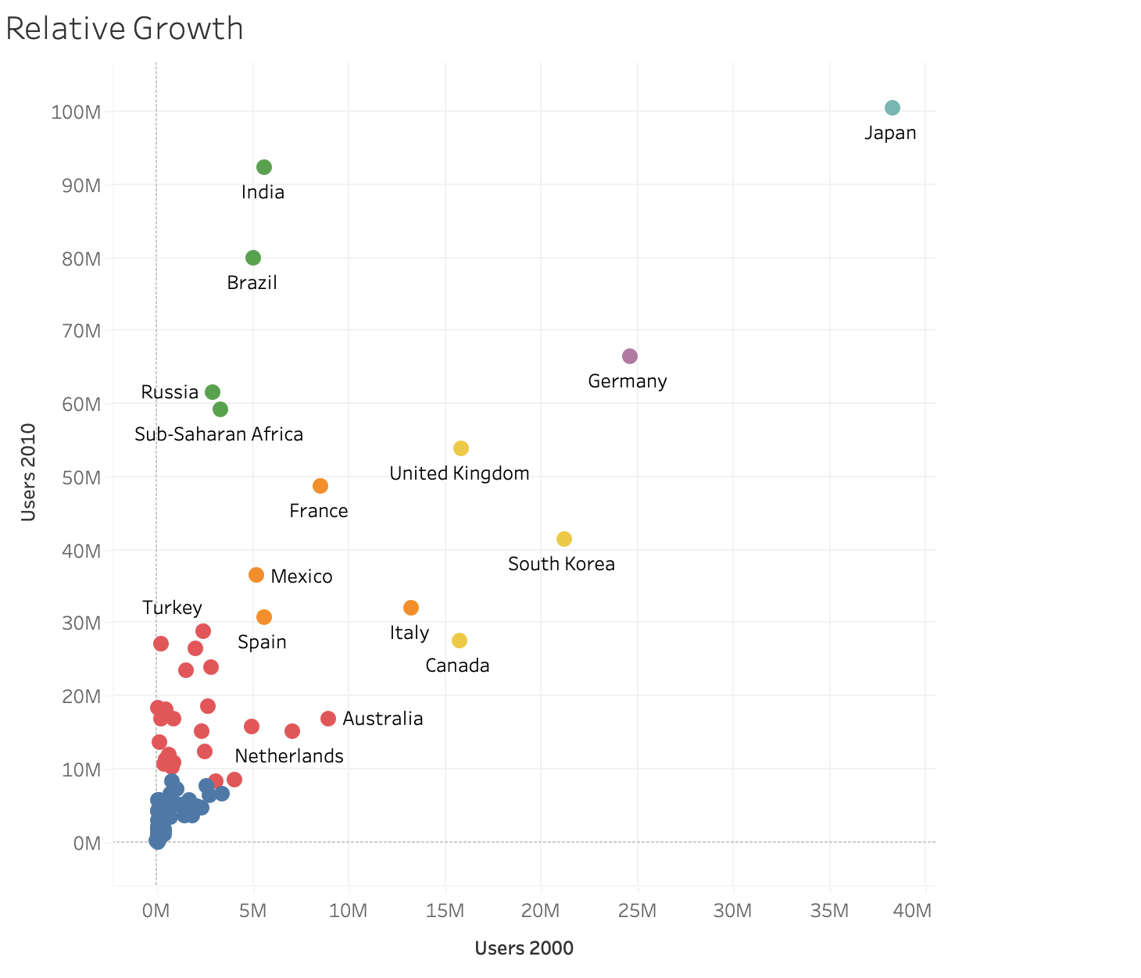
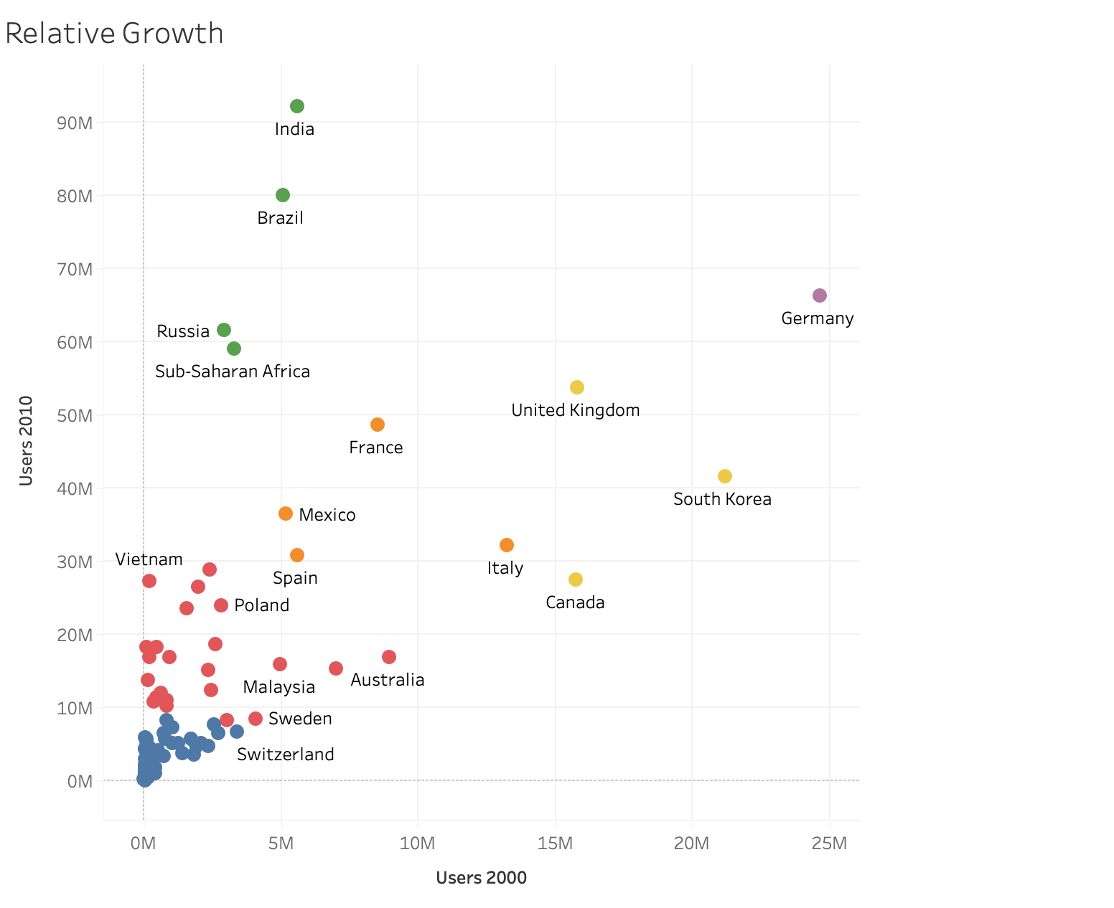
EDA 2000-2010
Relative Growth

Slide 11
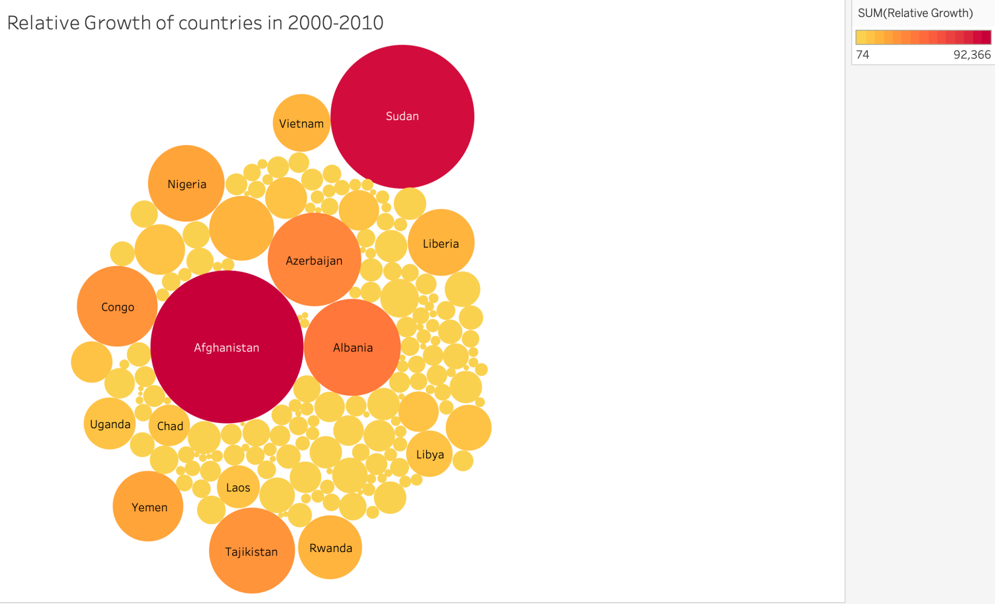
EDA 2000-2010(Maximum relative growth)

Slide 12
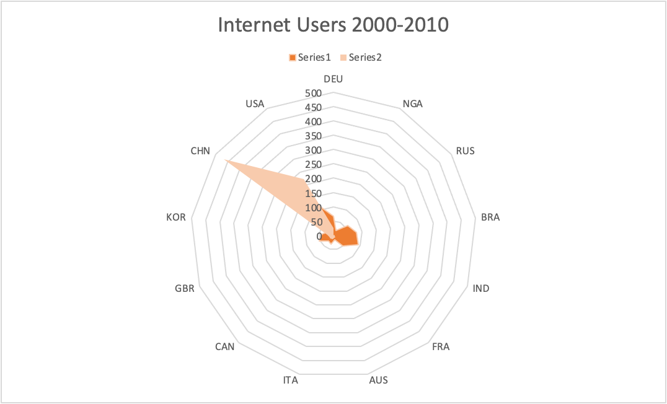
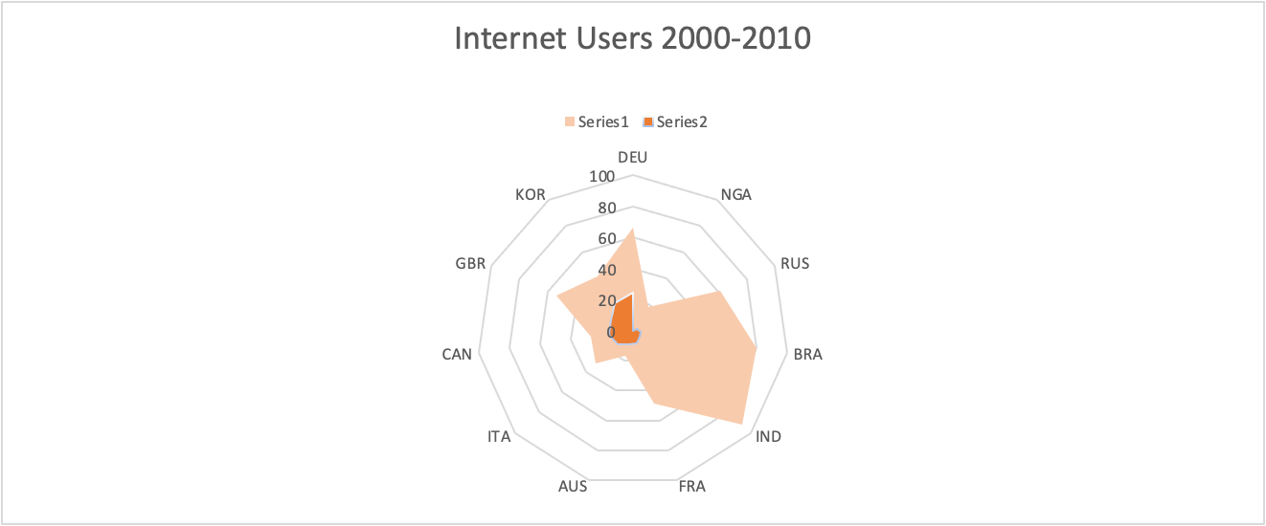
EDA 2000-2010

Slide 13
INSIGHTS
We can clearly spot the two main outliers, China and USA, followed by Japan and India. We take them out one by one to read the graph more clearly.
We can see two countries making immense relative growth in between the year 2000-2010, Afghanistan and Sudan, Afghanisthan had 1 k users in 2000 to 1 million users by 2010. Countries like nigeria also made huge progress from 0.2 million to 44 million in 10 years entering the top 10 rank from 61st rank in 2000.
In the third graph we see a dark orange patch which represent the internet users in 2000 and light orange represents the internet users in 2010. We can see a huge difference, and growth in countries such as Russia, India, United kingdom, Germany, Brazil and Italy.
The main reason that can be accounted for the growth of internet in this era has to be the increased rise of product availability that could access the internet, like laptop. Plus emerging browser like internet explorer was very popular.
Social media had very less impact at this time only some users of youtube and Facebook were a part of the community.

Slide 14
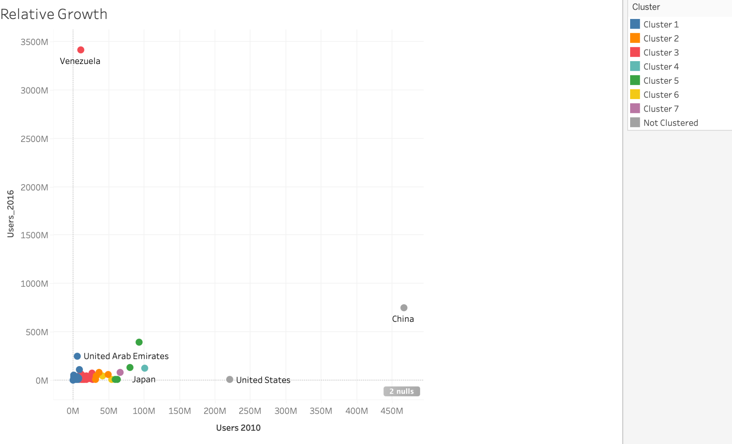
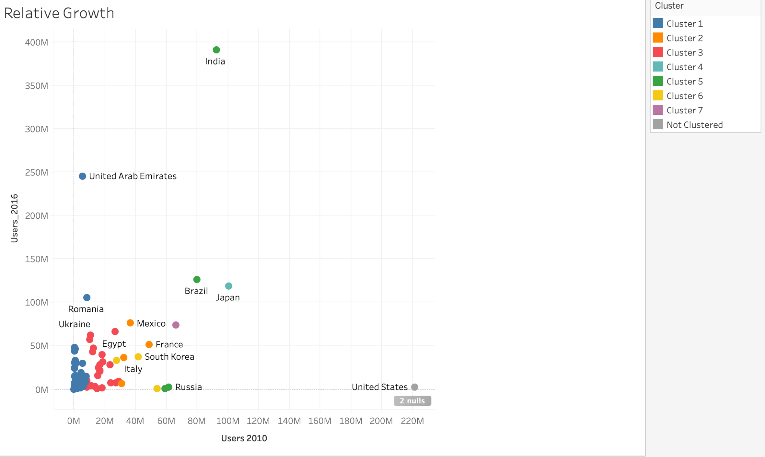
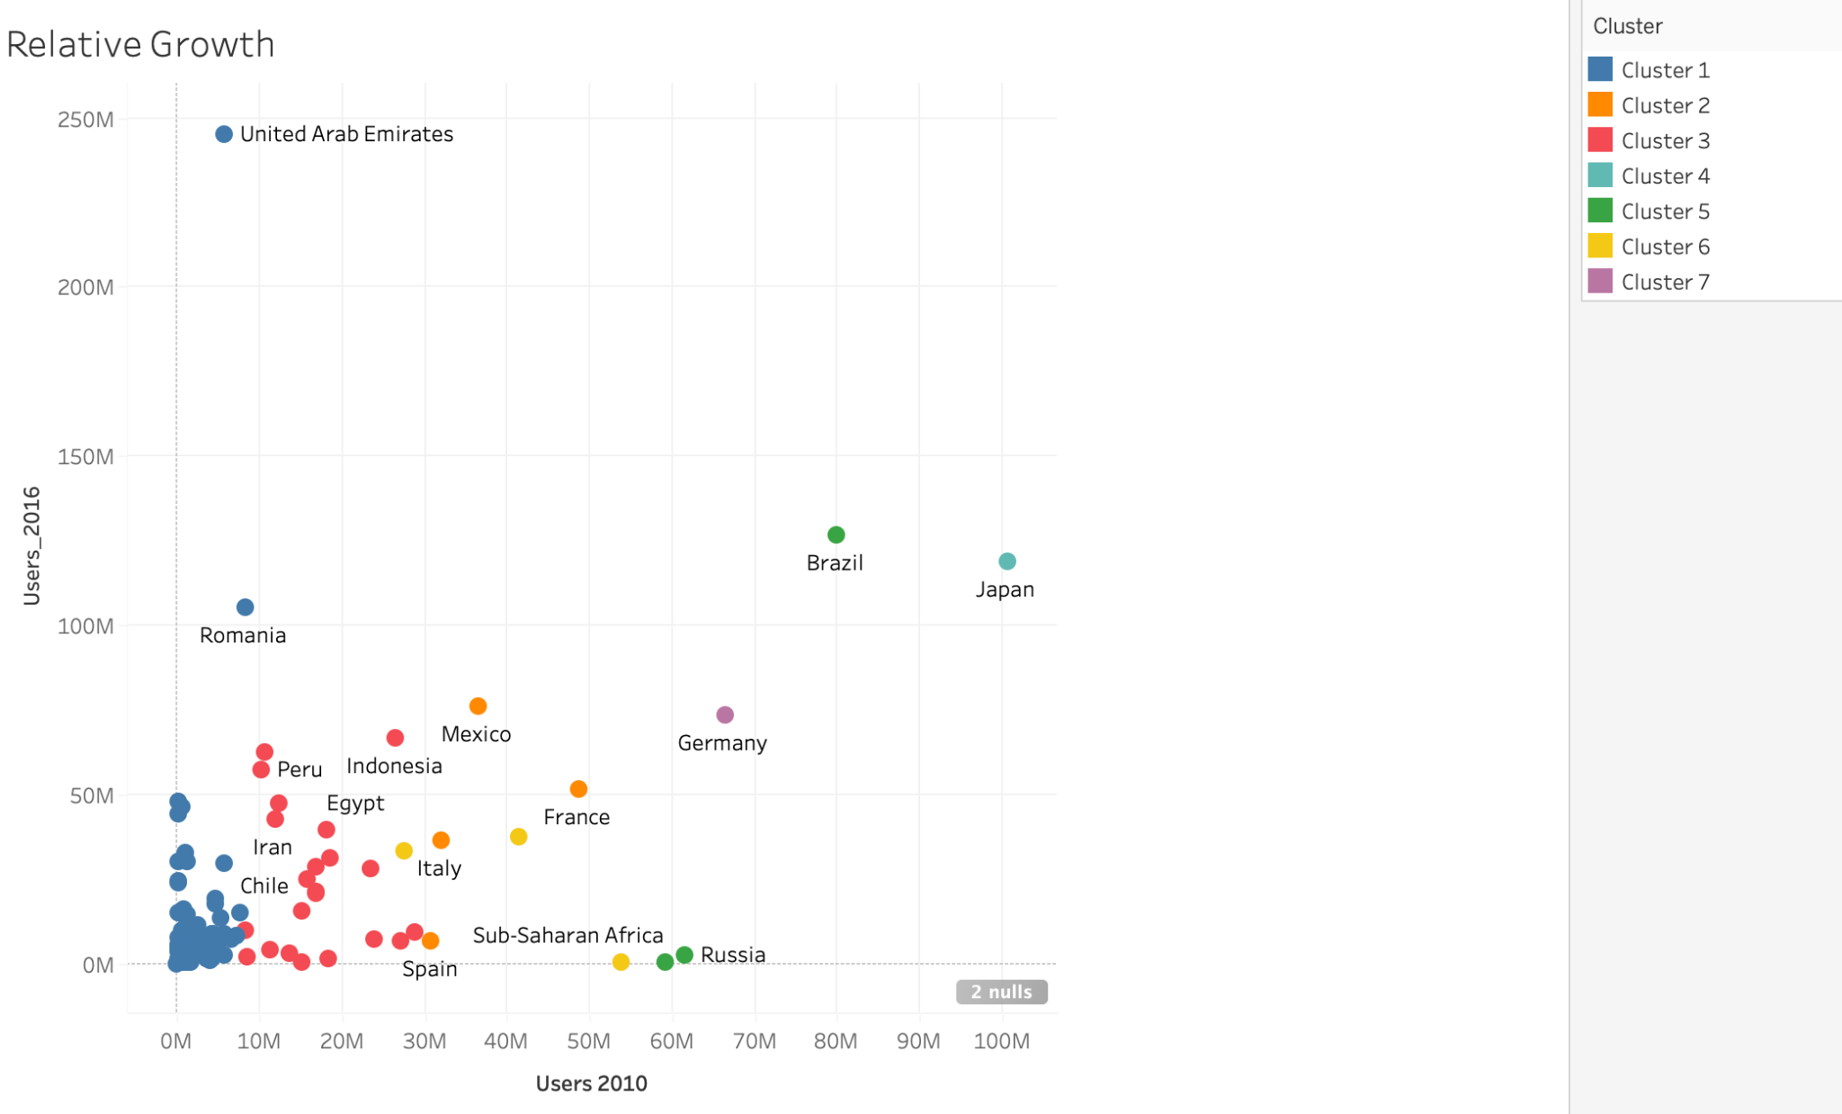
EDA 2010-2016

Slide 15
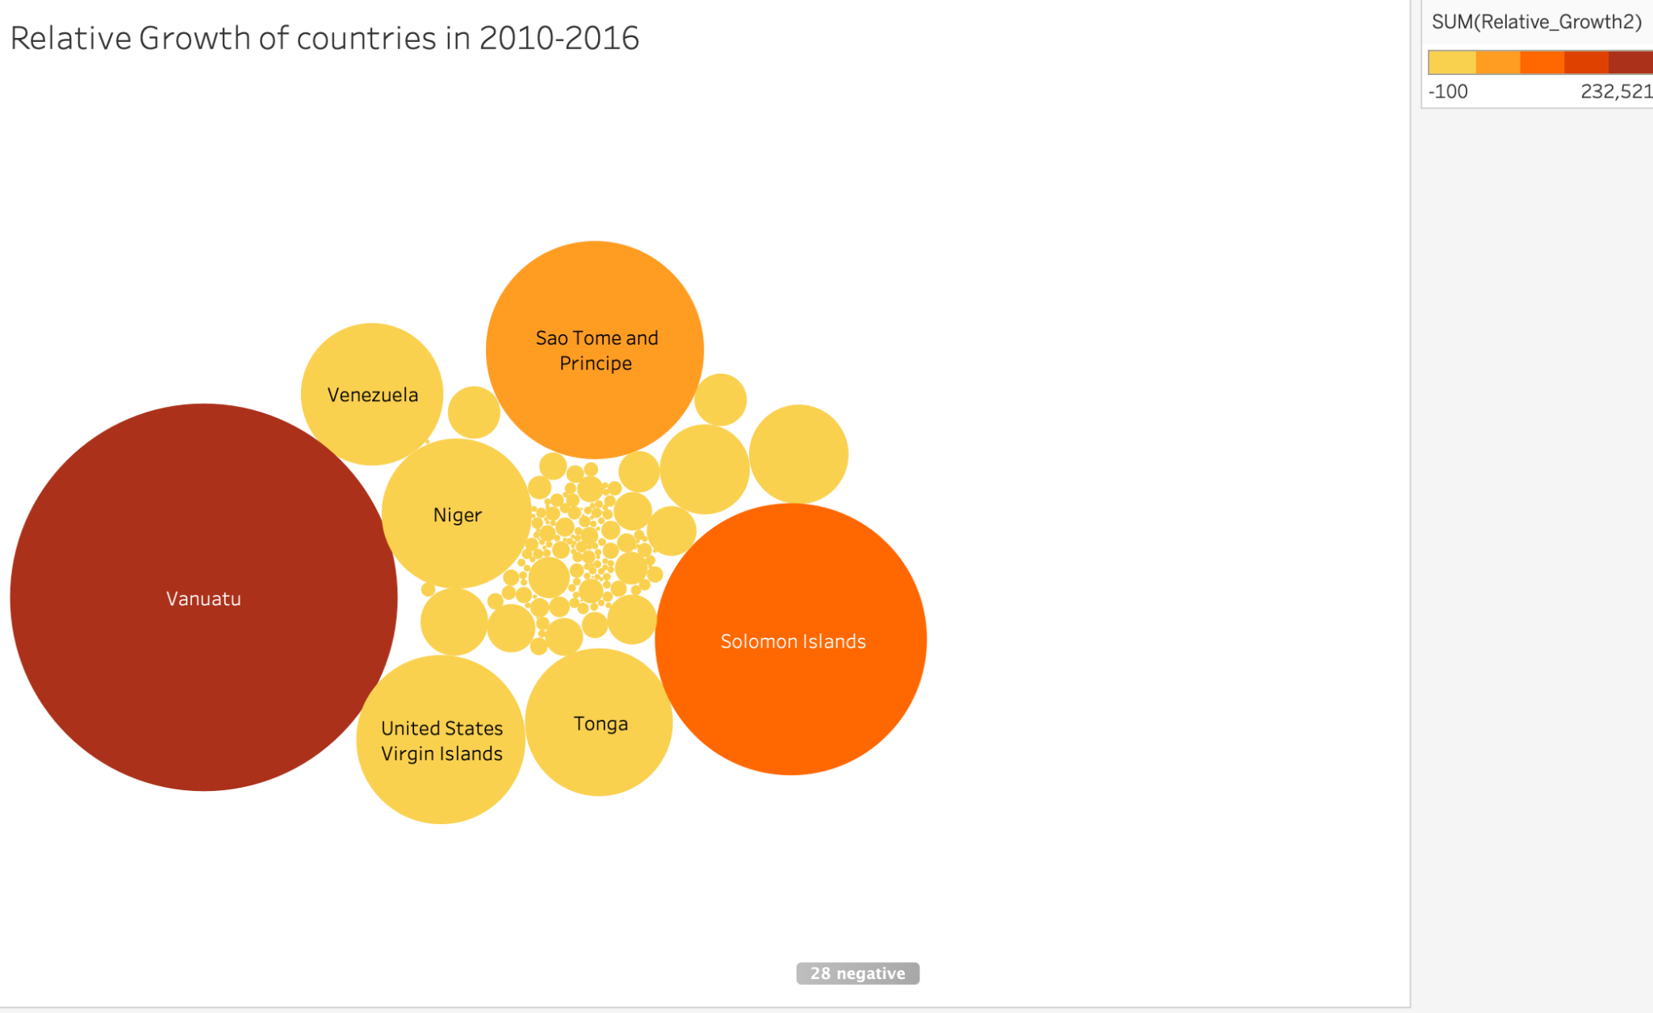
EDA 2010-2016(Maximum relative growth)

Slide 16
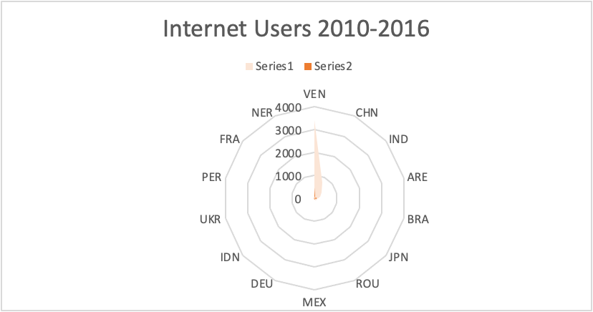
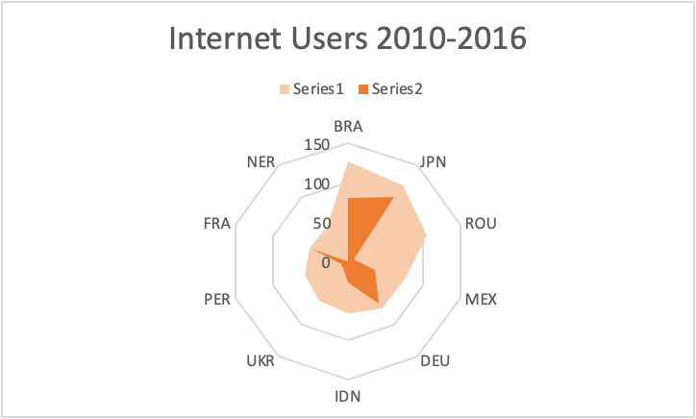
EDA 2010-2016

Slide 17
INSIGHTS
We can clearly spot the two main outliers, China and Venezuela, followed by UAE and India. We take them out one by one from the visualization to read the graph more clearly.
We can see two countries making immense relative growth in between the year 2010-2016, Vantanua and Solom islands.
In the third graph we see a dark orange patch which represent the internet users in 2010 and light orange represents the internet users in 2016. We can see a huge difference, and growth in countries such as Romania, Brazil,Japan, Ukraine and Peru.
The main reason that can be accounted for the growth of internet in this era has to be the increased rise broadband services and the introduction of smartphones, we will further see how internet was affected by these factors. Plus it took a huge boom in the growth, after the sudden immense growth of social media.
We can only see it rising from here.

Slide 18
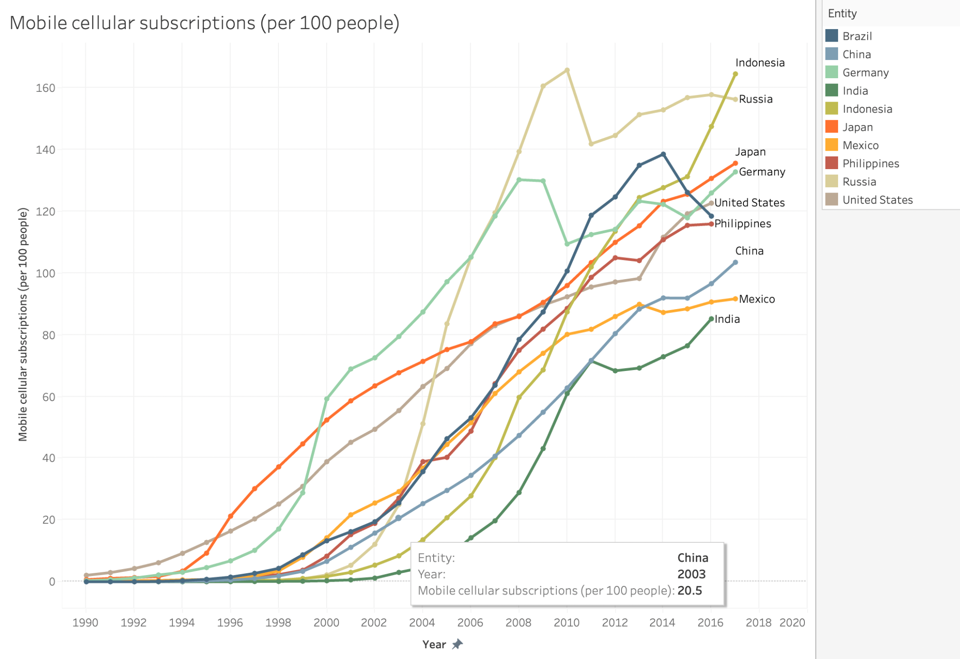
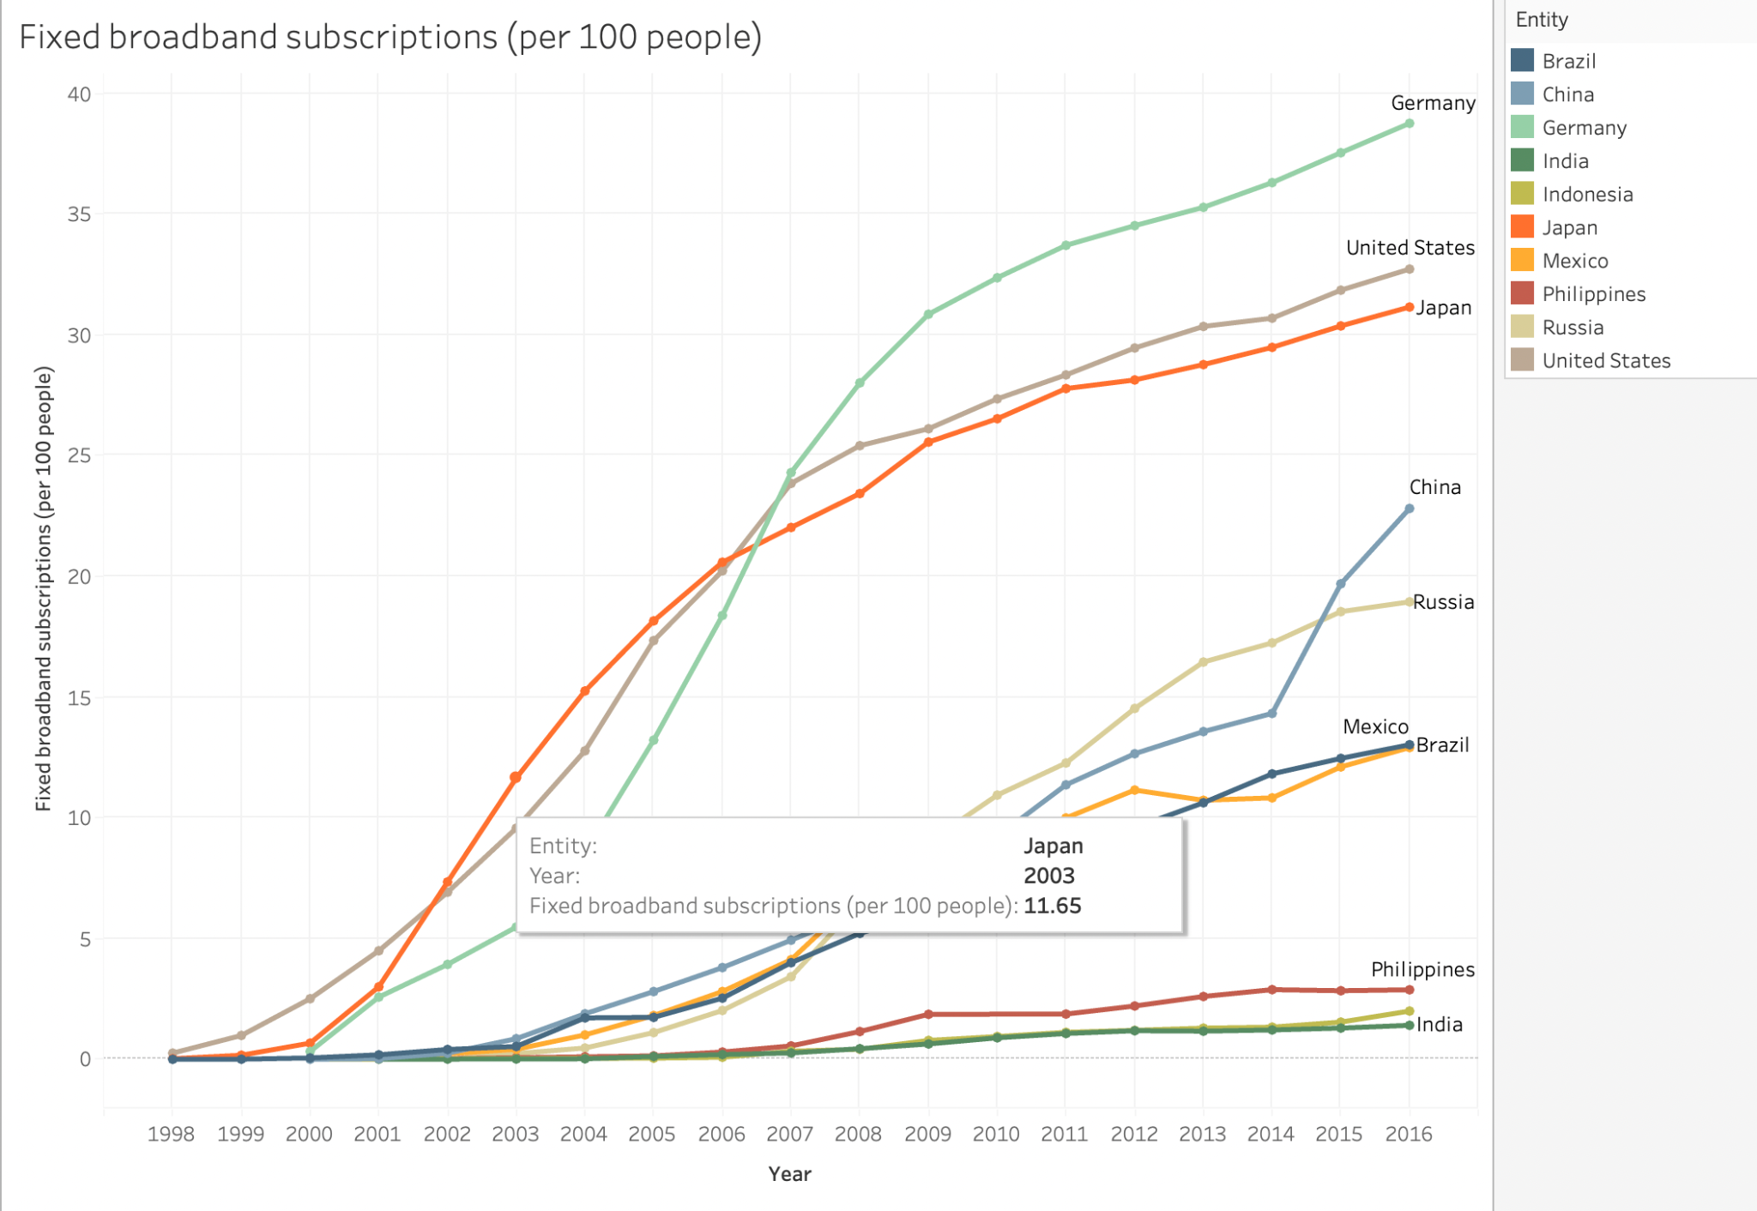
Affect of Mobile and Broadband services on internet users
Mobile Cellular Subcriptions
FIXED BROADBAND SERVICES

Slide 19
Insights
We can see similarity in most of the countries like Germany, United states, China and Japan. Here internet was first accessible and it can be clearly seen from the data that these countries have equal contribution in broadband subscriptions and mobile subscriptions.
But if you have a closer look at countries like India or Indonesia you will notice that major part of the growth by users who have mobile subscriptions.
Plus we can see a rise in 2006 and that graph keeps rising, it is very similar to the internet user graph so it is safe to say that mobile and broadband usage increased the internet user by a great margin, specially the introduction of smart phones.

Slide 20
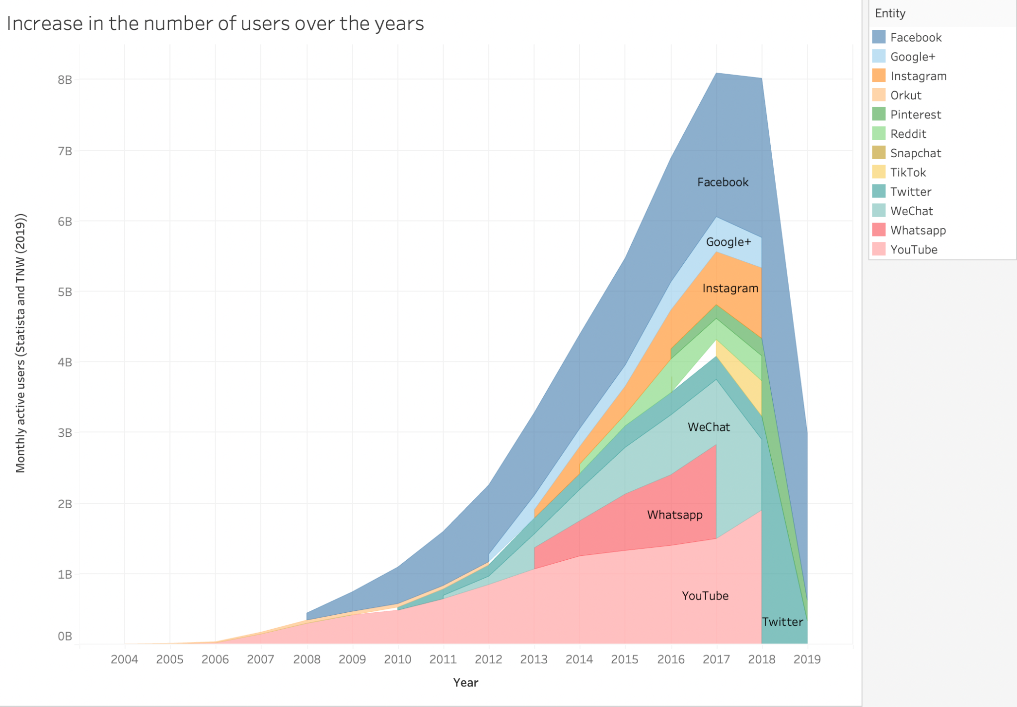
INCREASE IN NUMBER OF SOCIAL MEDIA USERS

Slide 21
Rise of Social Media
There is nothing in the history of internet that can impact its growth as effectively as social media. It also includes the rise of E-commerce platforms.
We can notice that almost all the social platforms begin in mid 2012 and have grown to unbelievably high user rate.
If we look at the most used social media of all time, the facebook, it had about 1 billion users in mid 2012 to and figure have risen to 8 billion users by 2018.
This had a great impact in the rise of internet users, plus the pandemic has boosted the internet users by a great margin in the last couple of years.

Slide 22
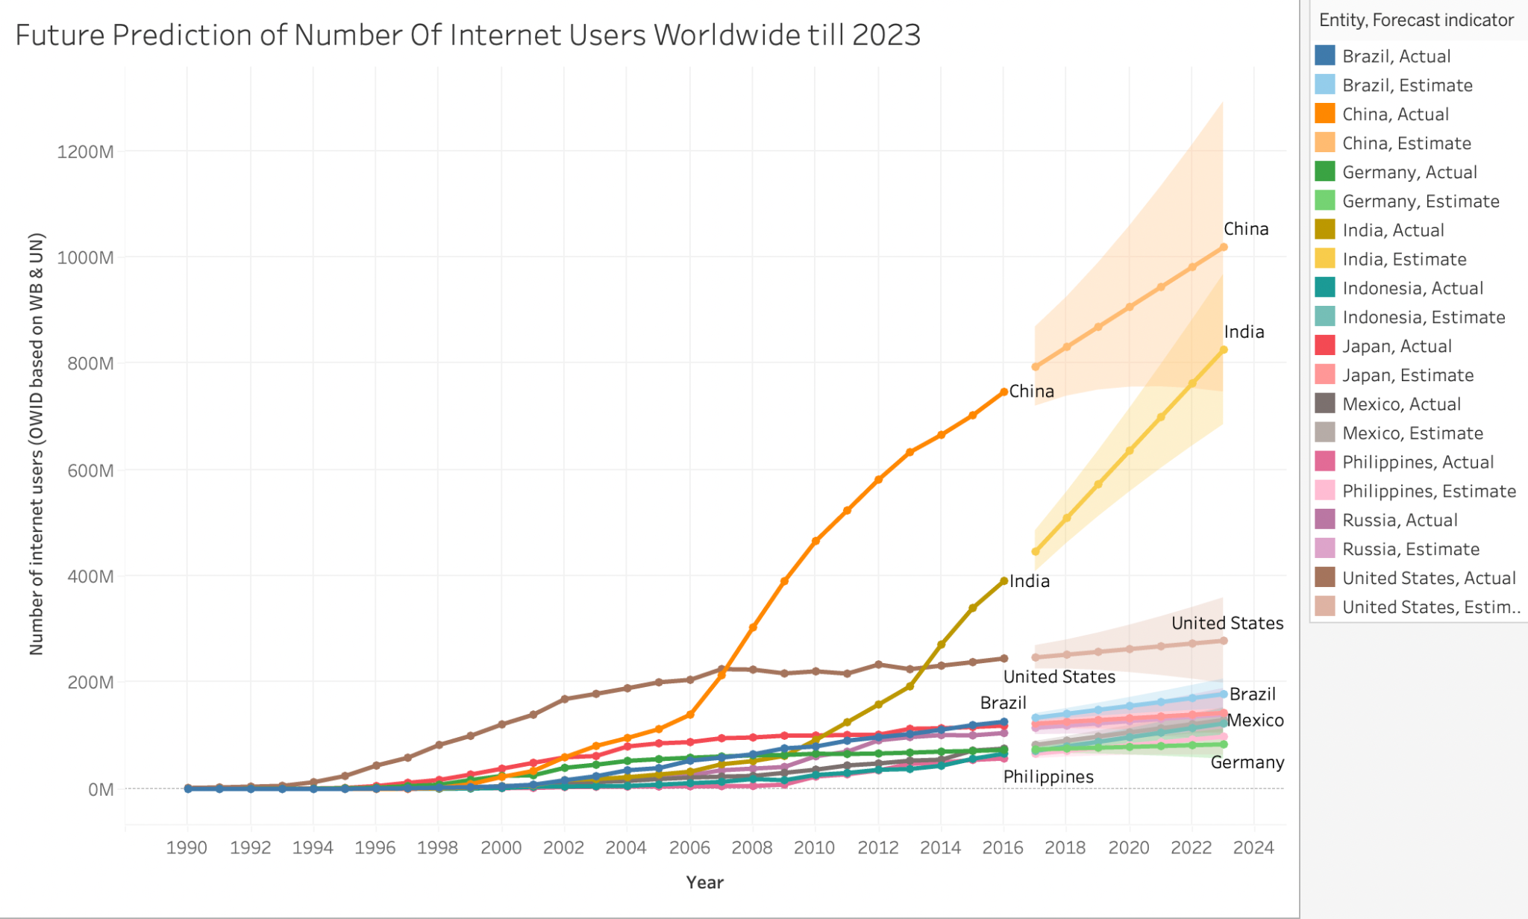
FUTURE PREDICTION

Slide 23
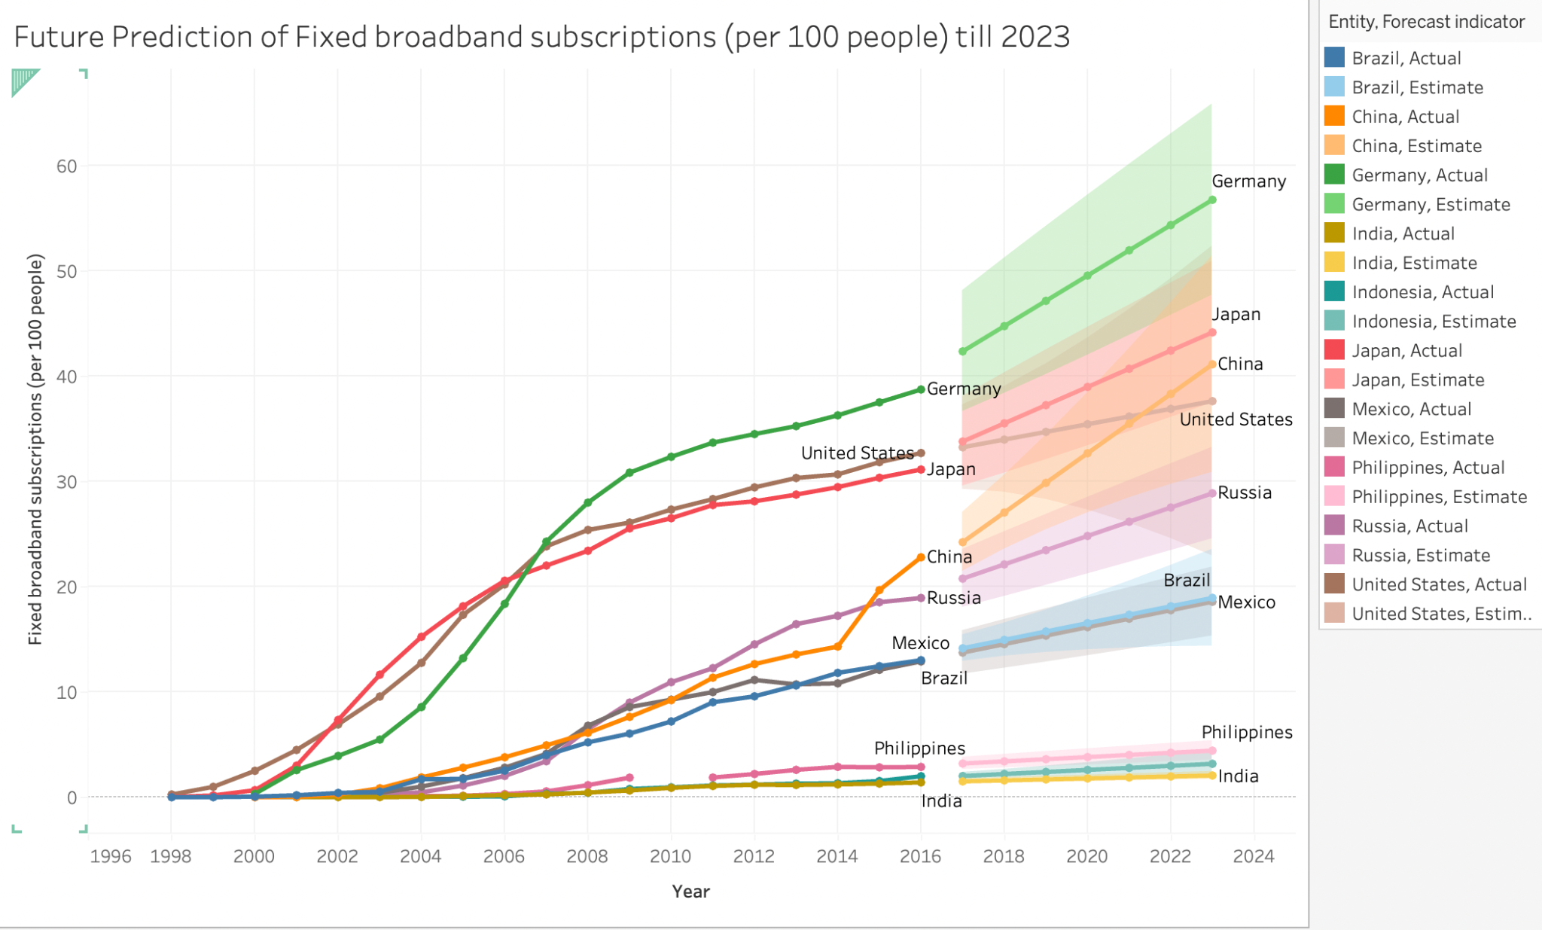
PREDICTION OF FIXED BROADBAND SUBSCRIPTION

Slide 24
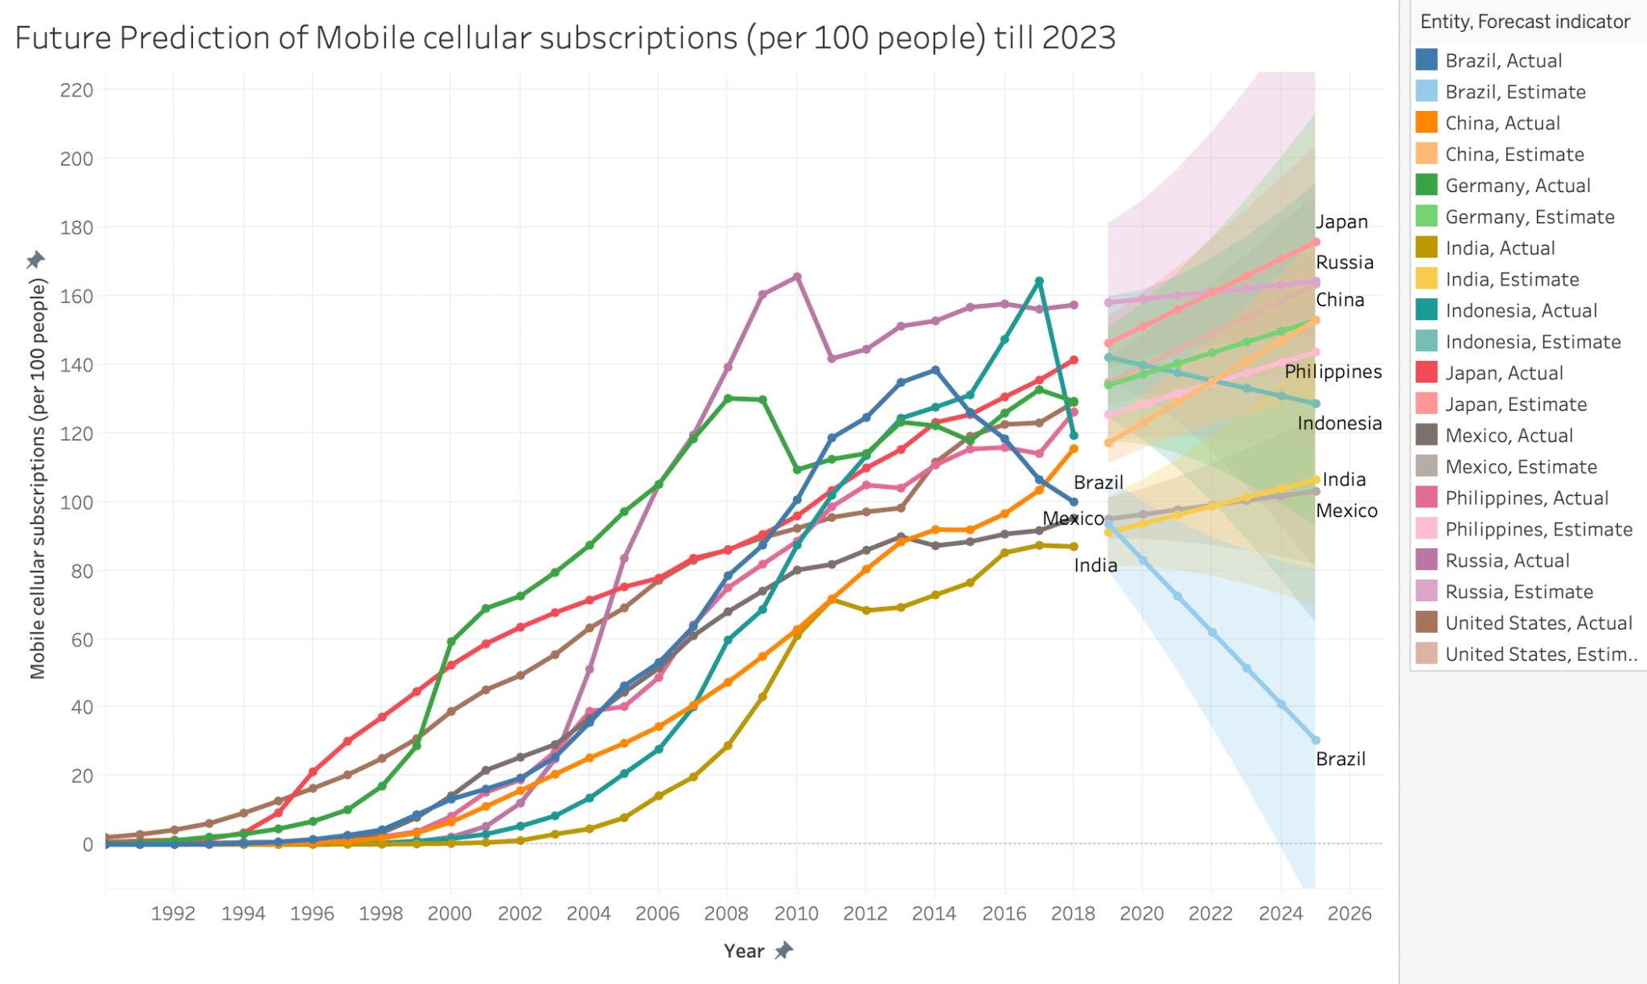
PREDICTION OF MOBILE CELLULAR SUBSCRIPTION

Slide 25
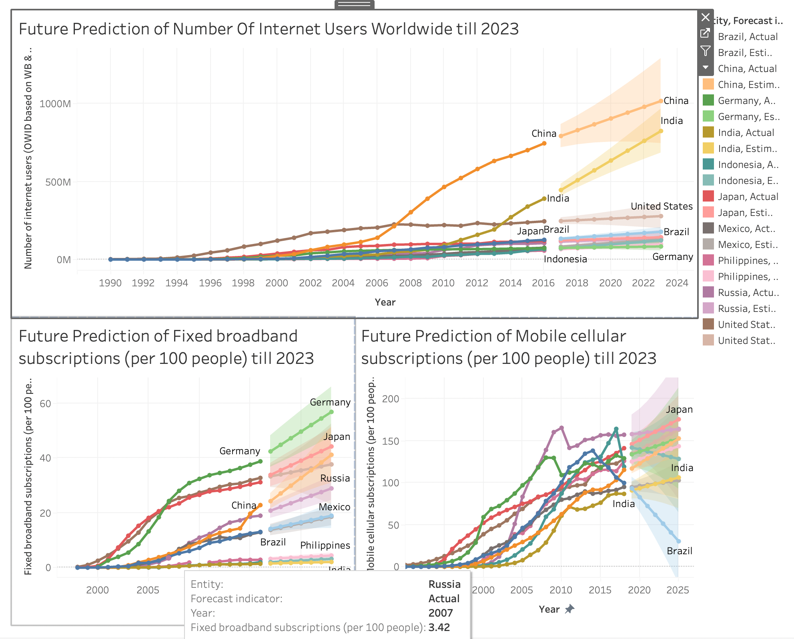
DASHBOARD

Slide 26
FUTURE OF INTERNET
As we can see from the data, that the usage of internet has been increasing drastically over the past few years. As per the research China and india are expected to have the highest internet user by the year 2023.
We can see from the chart that the user in India are expected increasing from 400 million to 800 million by 2023 there can be several reasons to the growth of the user,the new emerging technologies coming in. Iot without any question is at the beginning of its golden age.
As we have all seen after the pandemic the digital transformation has been given a huge importance in most of the industries.
Introduction of blockchain to Iot and increasing demand for cryptocurrency, as delivering bitcoin transaction data to miners requires internet enabled-devices can also be the reason for the user of internet to shoot up in the coming years.

